Slide 1
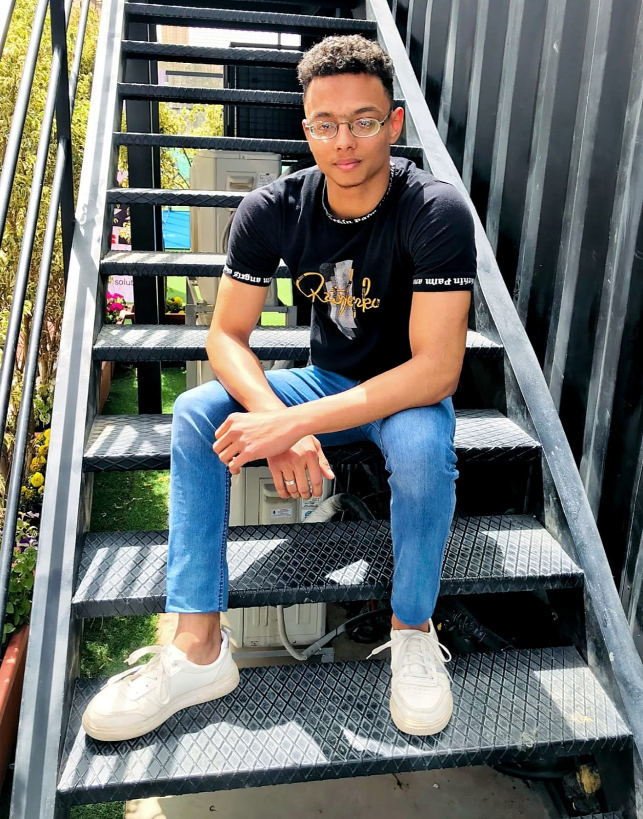

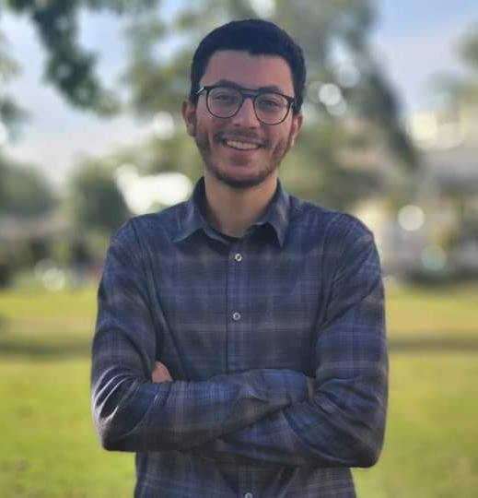
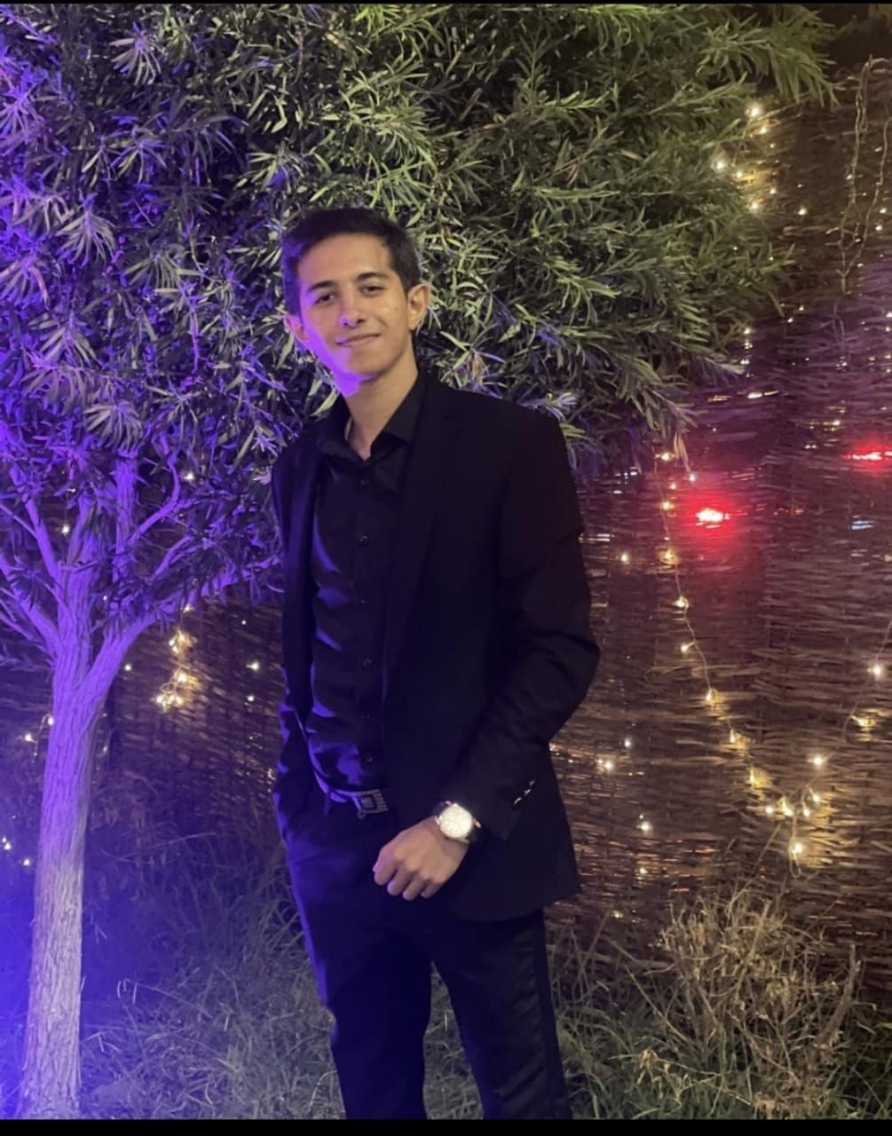

Ahmed Nazeer
Team leader
NourEldin Ekramy Amgad Nabil Youssef Aly Ahmed Hosny

Slide 2


Library System
Gunners Team

Slide 3
How did we get the idea of the project?
Ok in the beginning I want to talk about something which is libraries.
Some people to find the book they want they search a lot in libraries and bookshops to find what they need, and they might not find it and that takes a lot of effort and time.
So, we got an idea which to make every library have an app for itself to put the books and their data like number of pages, the author, book type and its price, so when someone wants a specific book, he looks for it on the app if it’s available or not. if it’s available he can either borrow or buy it.

Slide 4
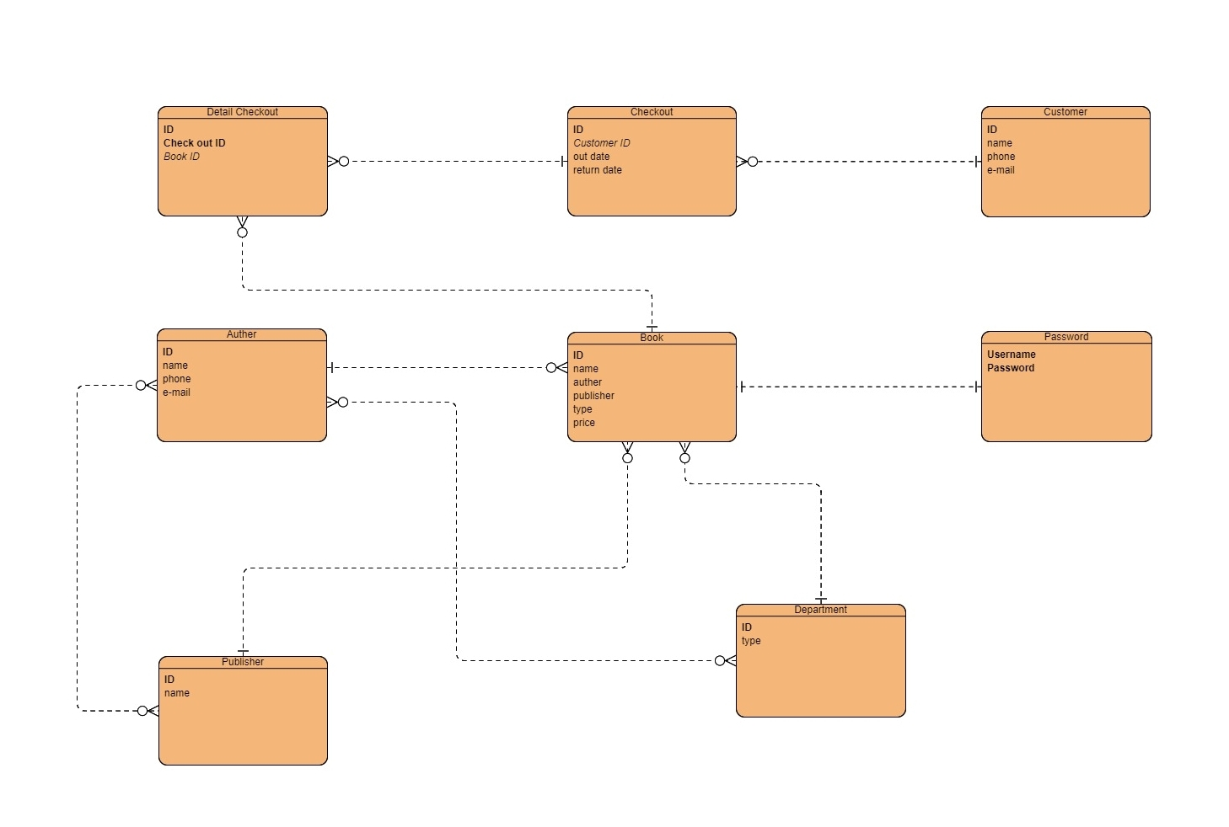
E.R Diagram for Library System

Slide 5
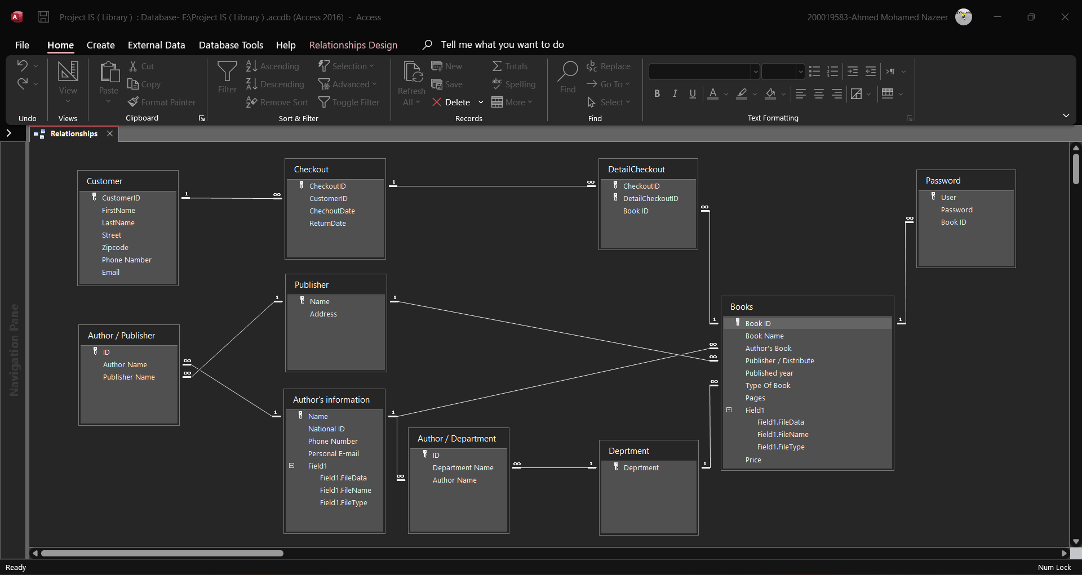
Relationships in Access

Slide 6
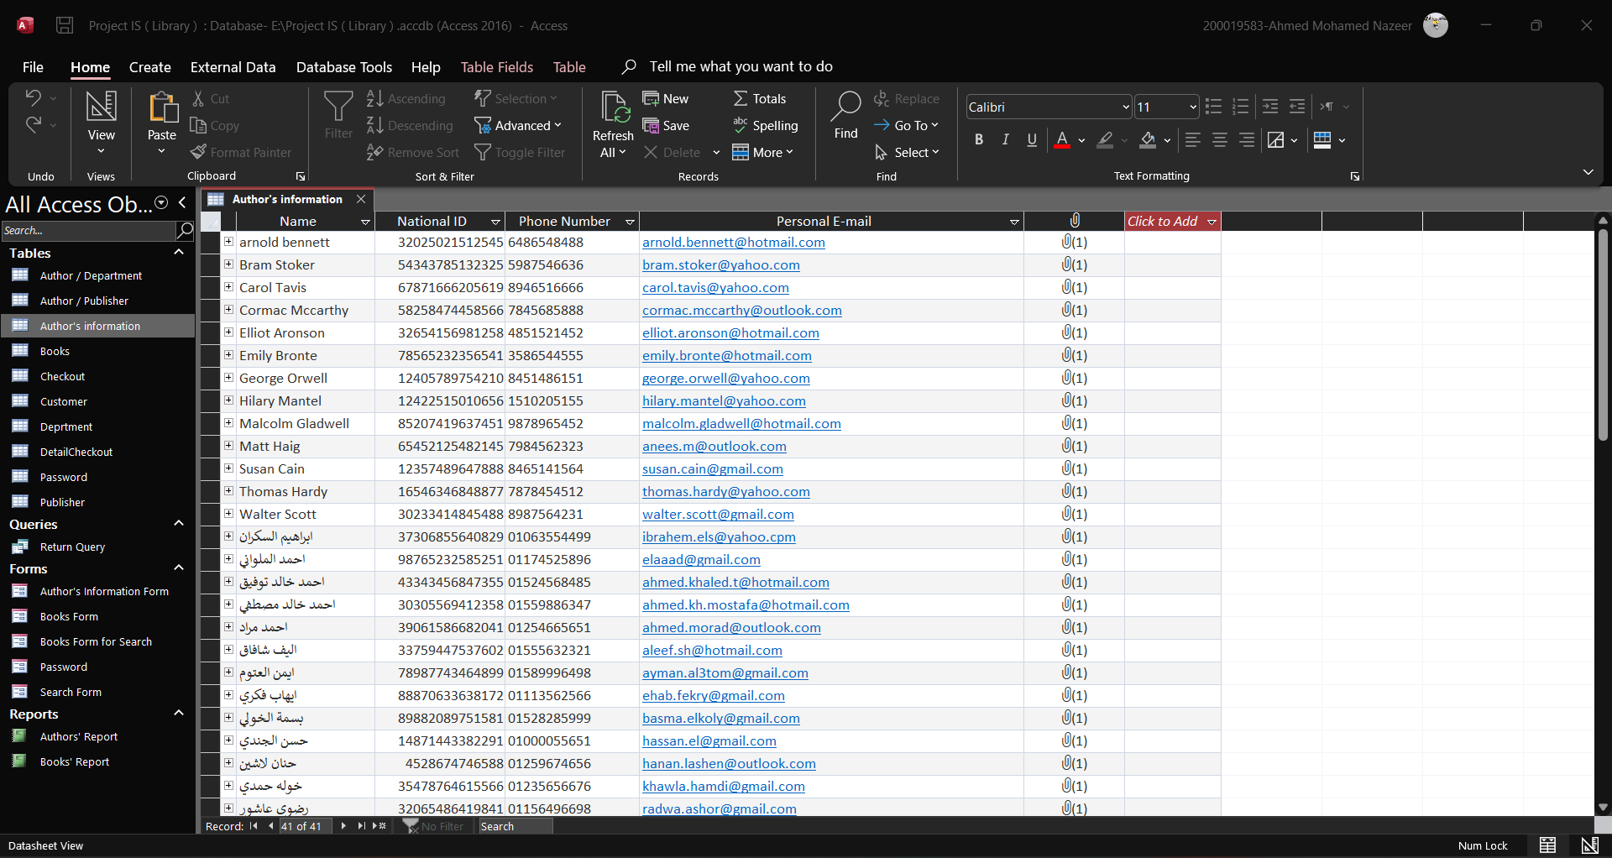
Author's information

Slide 7
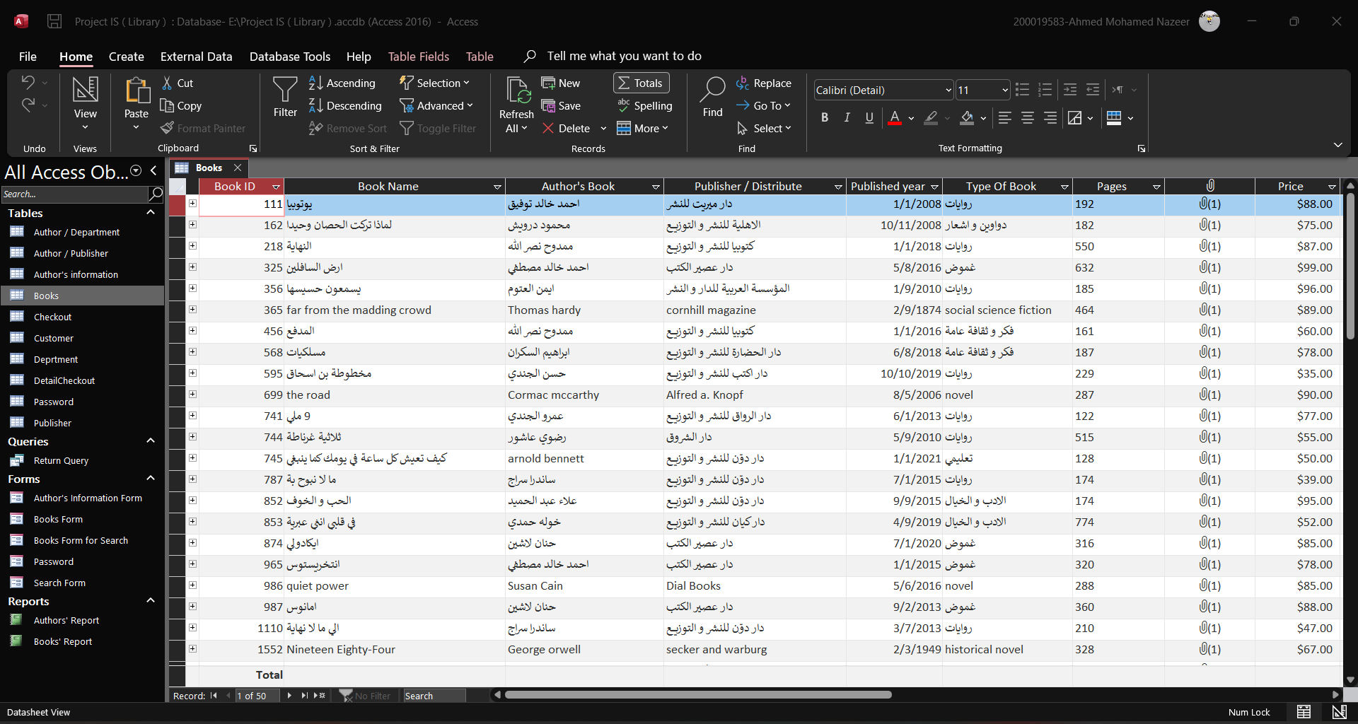
Books

Slide 8
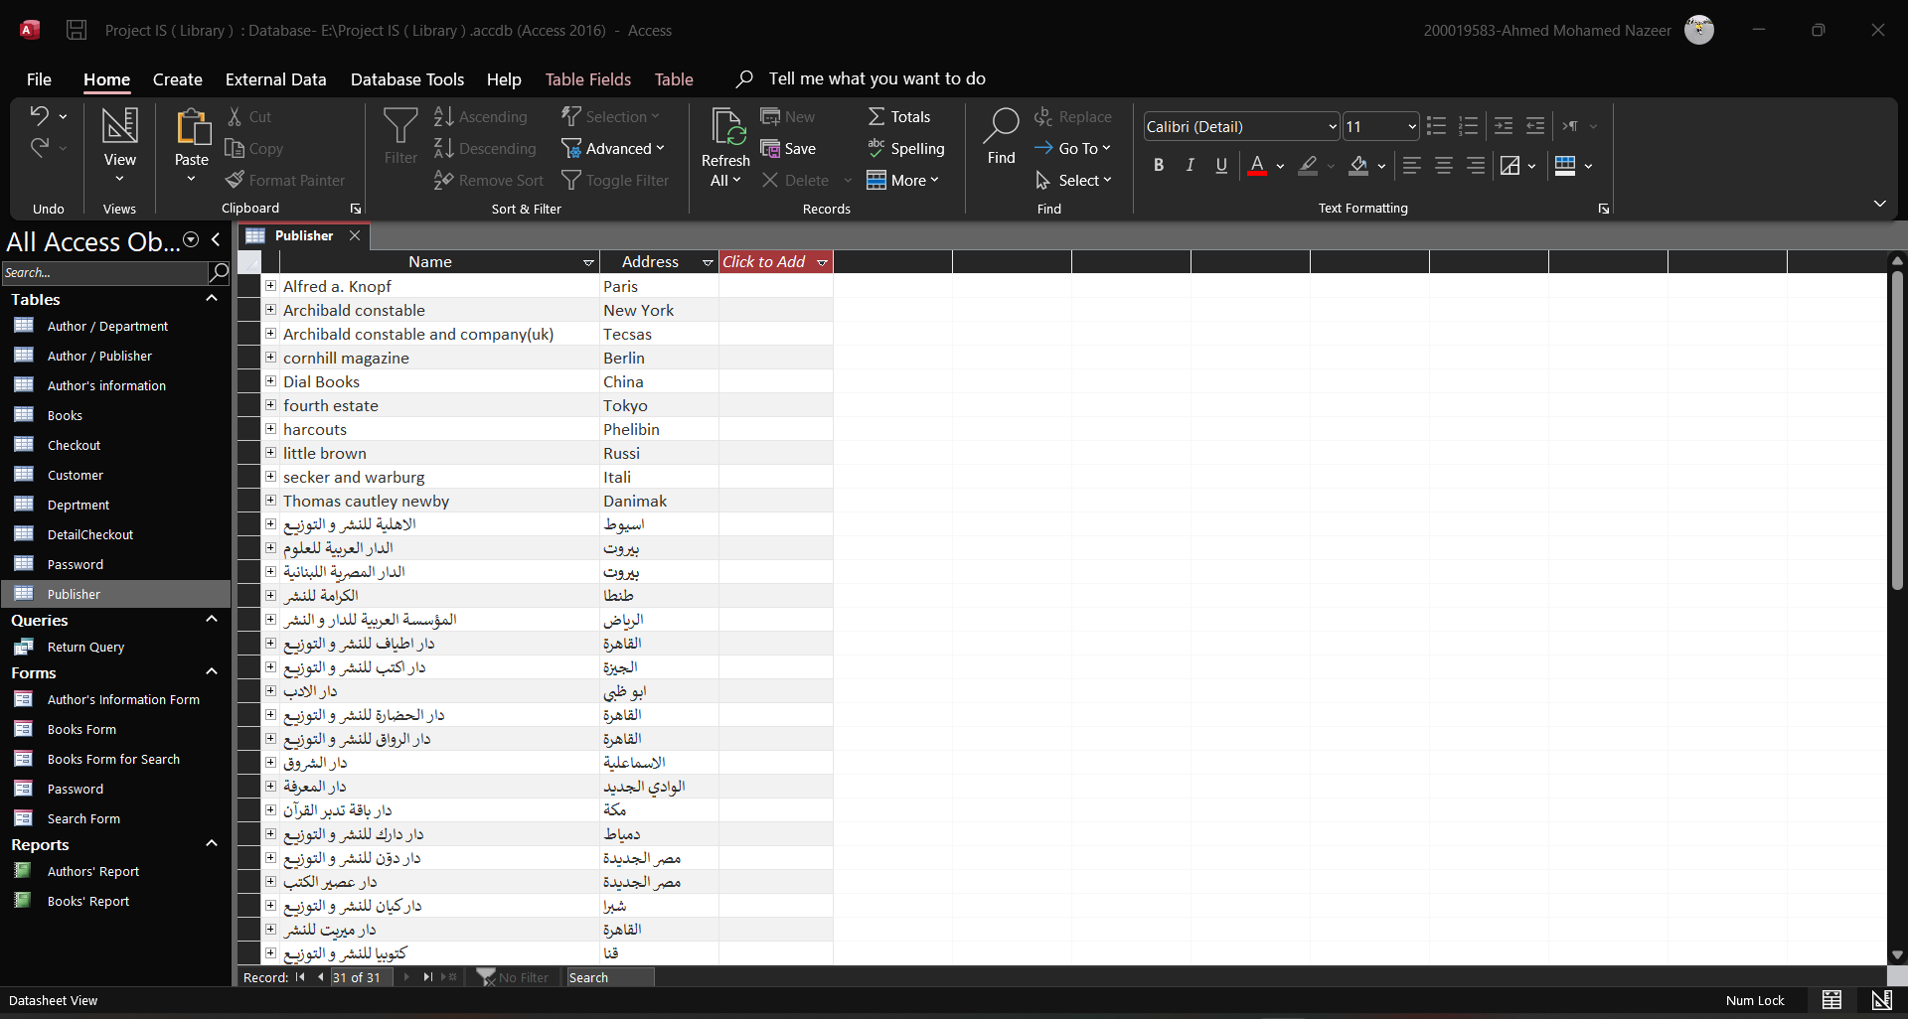
Publisher

Slide 9
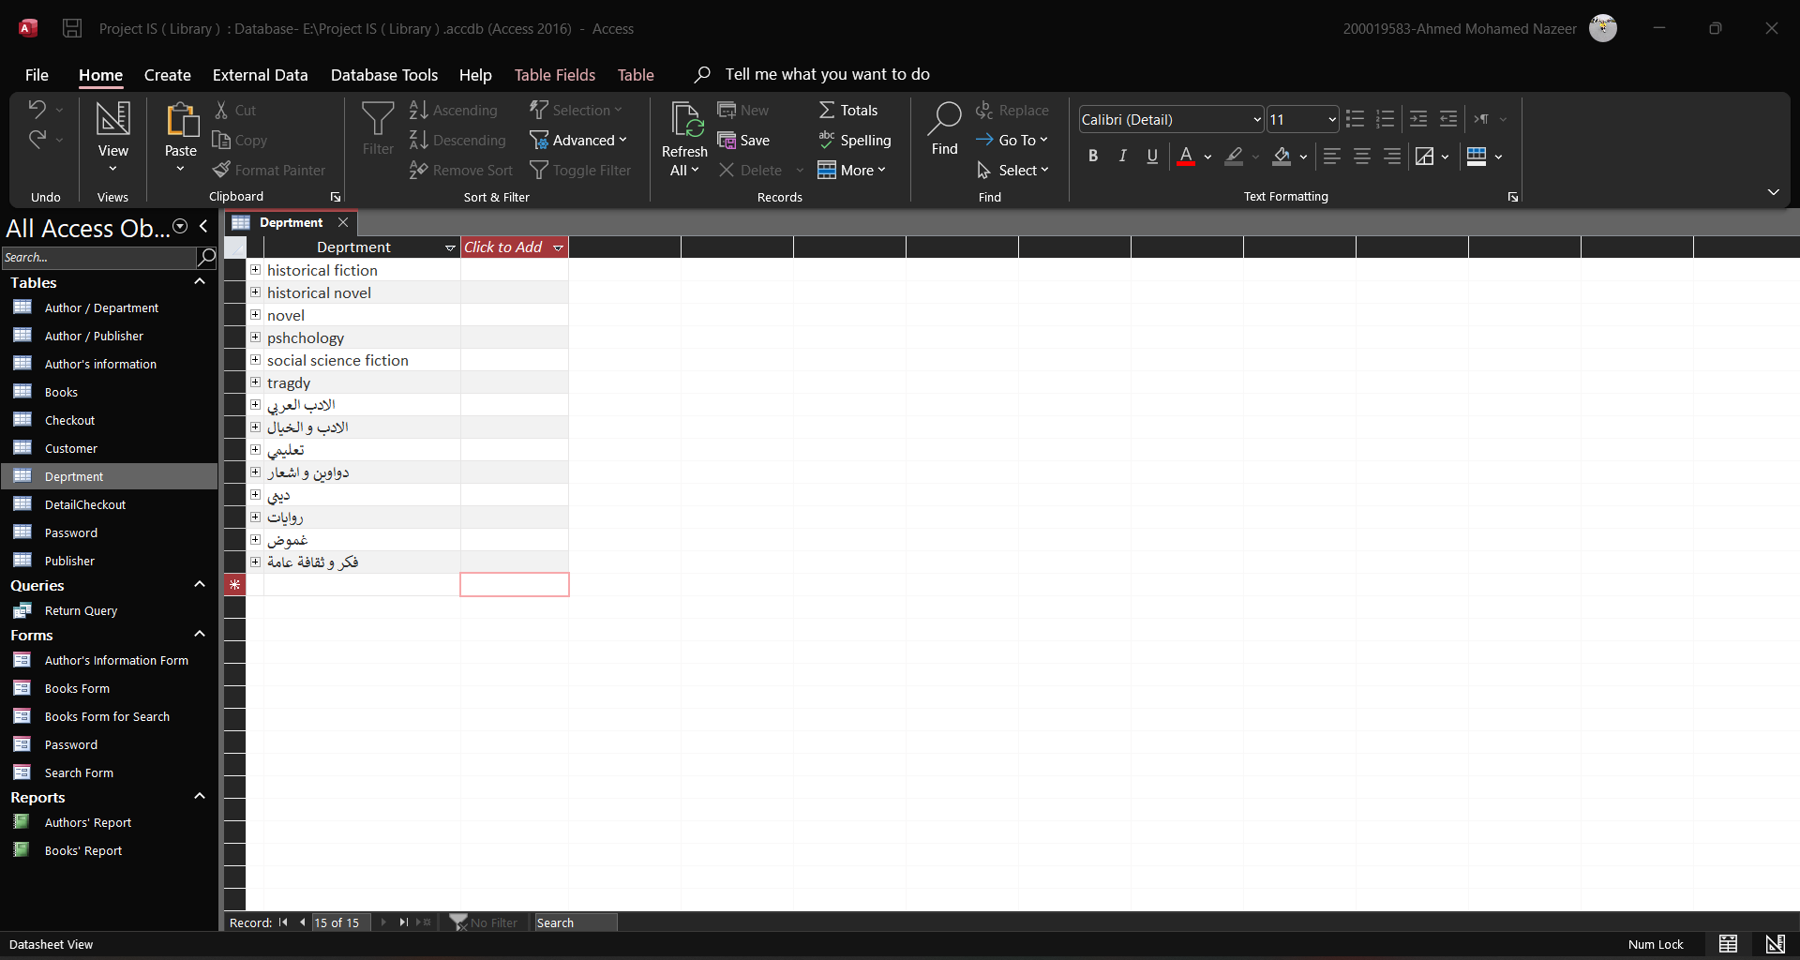
Department

Slide 10
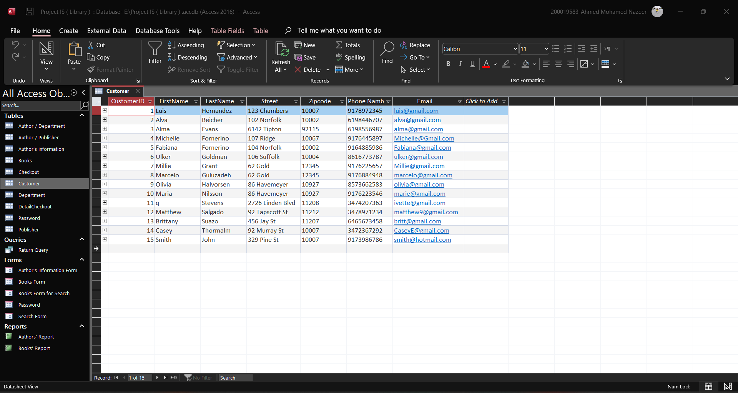
Customer

Slide 11
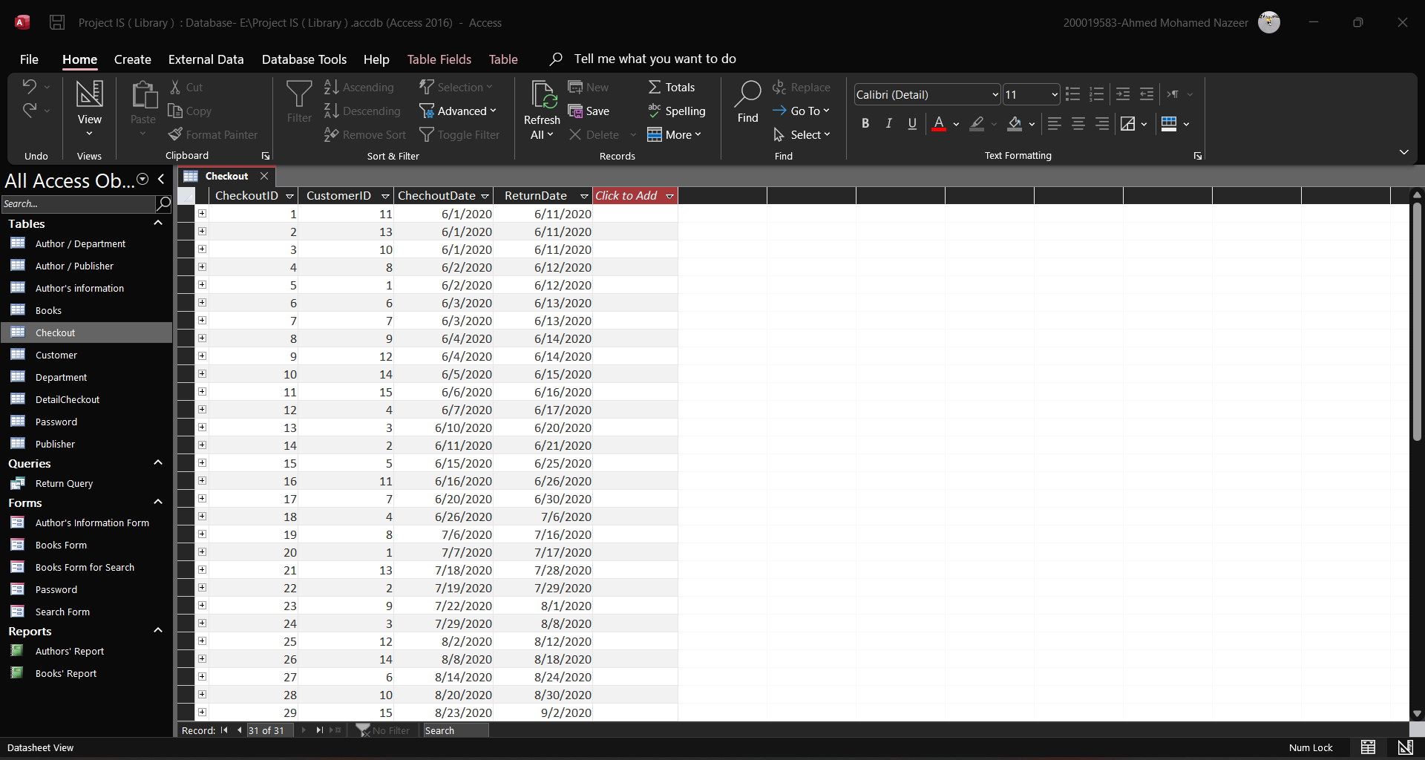
Checkout

Slide 12
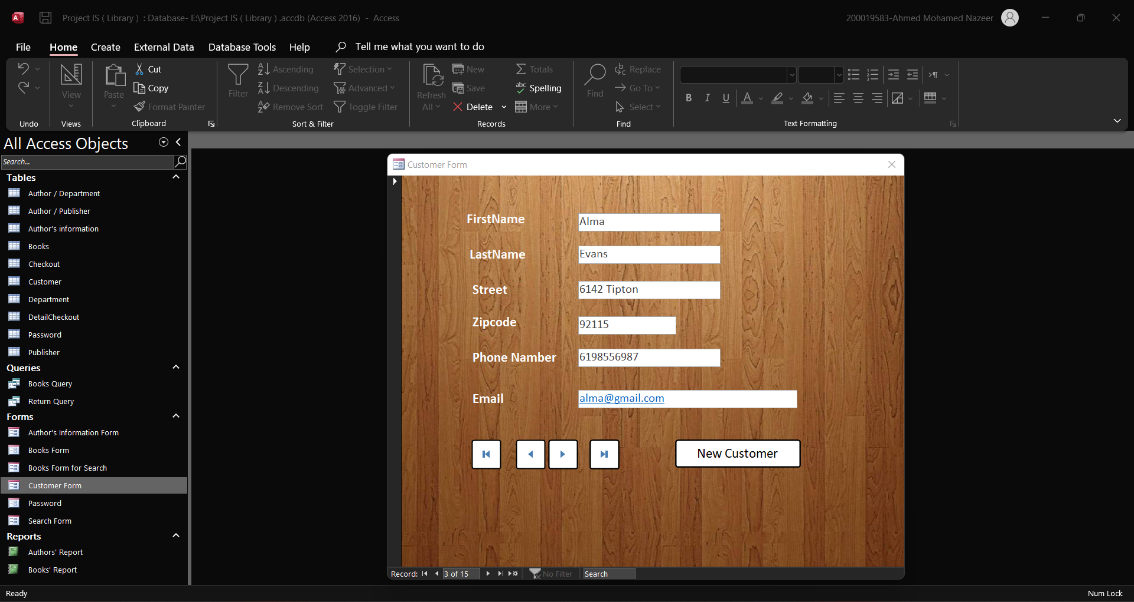
Customer Form

Slide 13
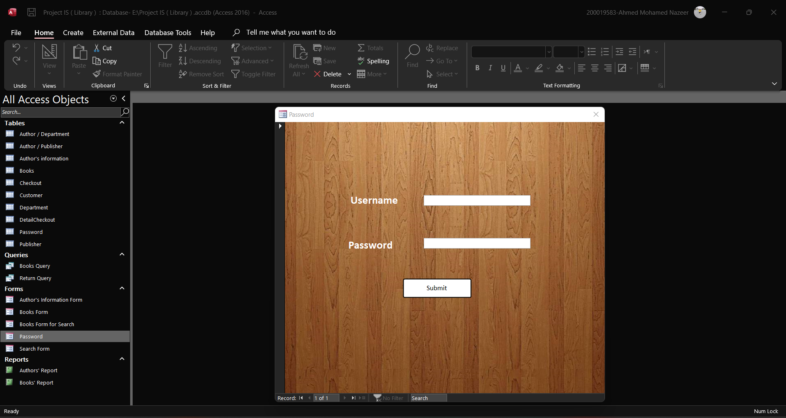
Login Form

Slide 14
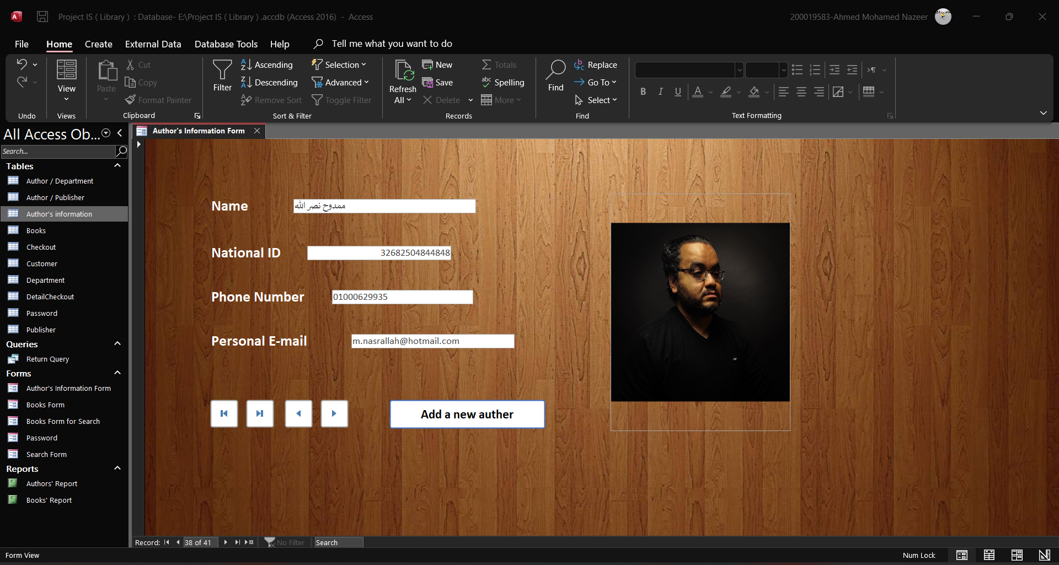
Authors Form

Slide 15
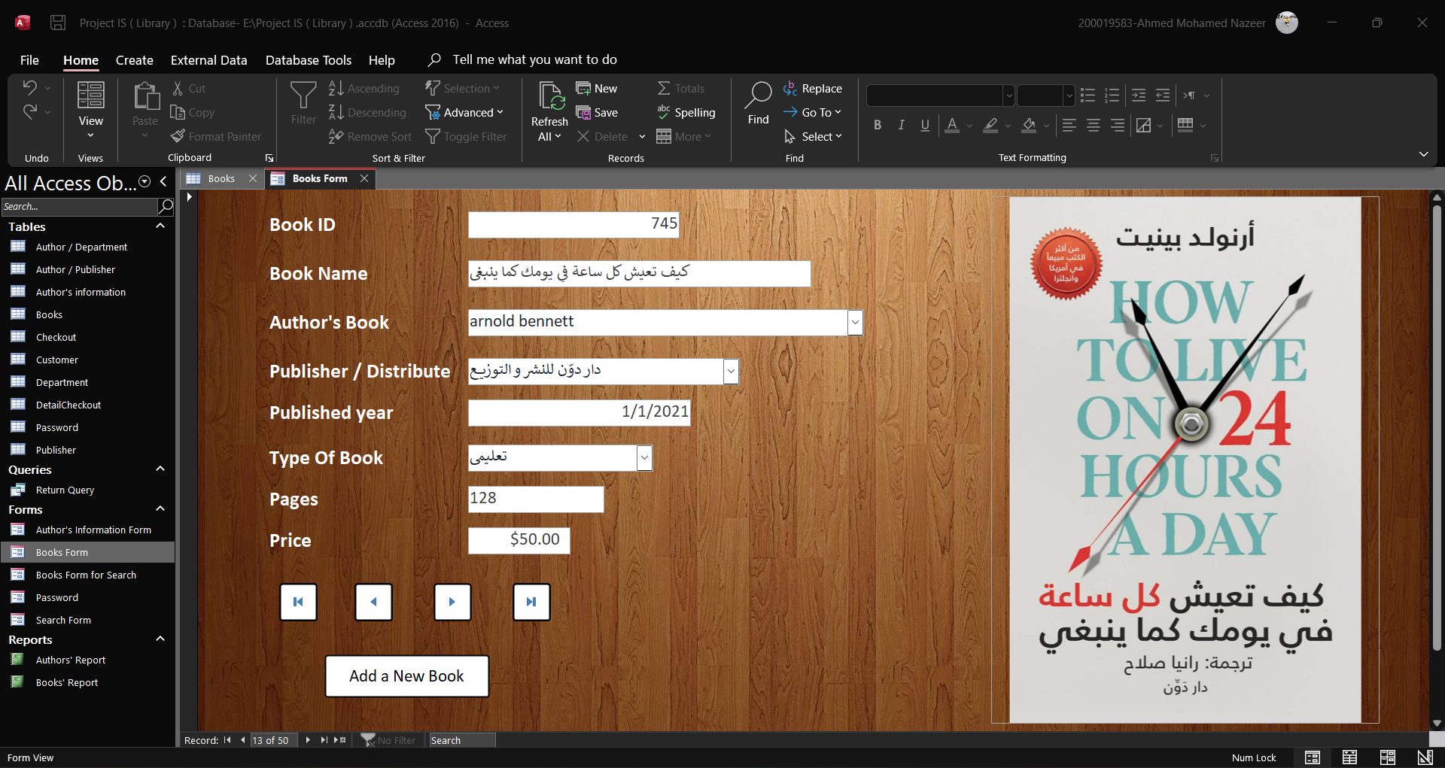
Books Form

Slide 16
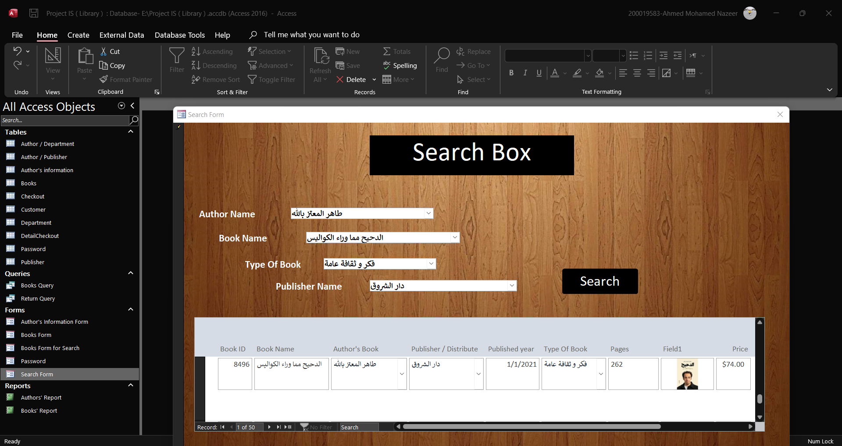
Search Box Form

Slide 17
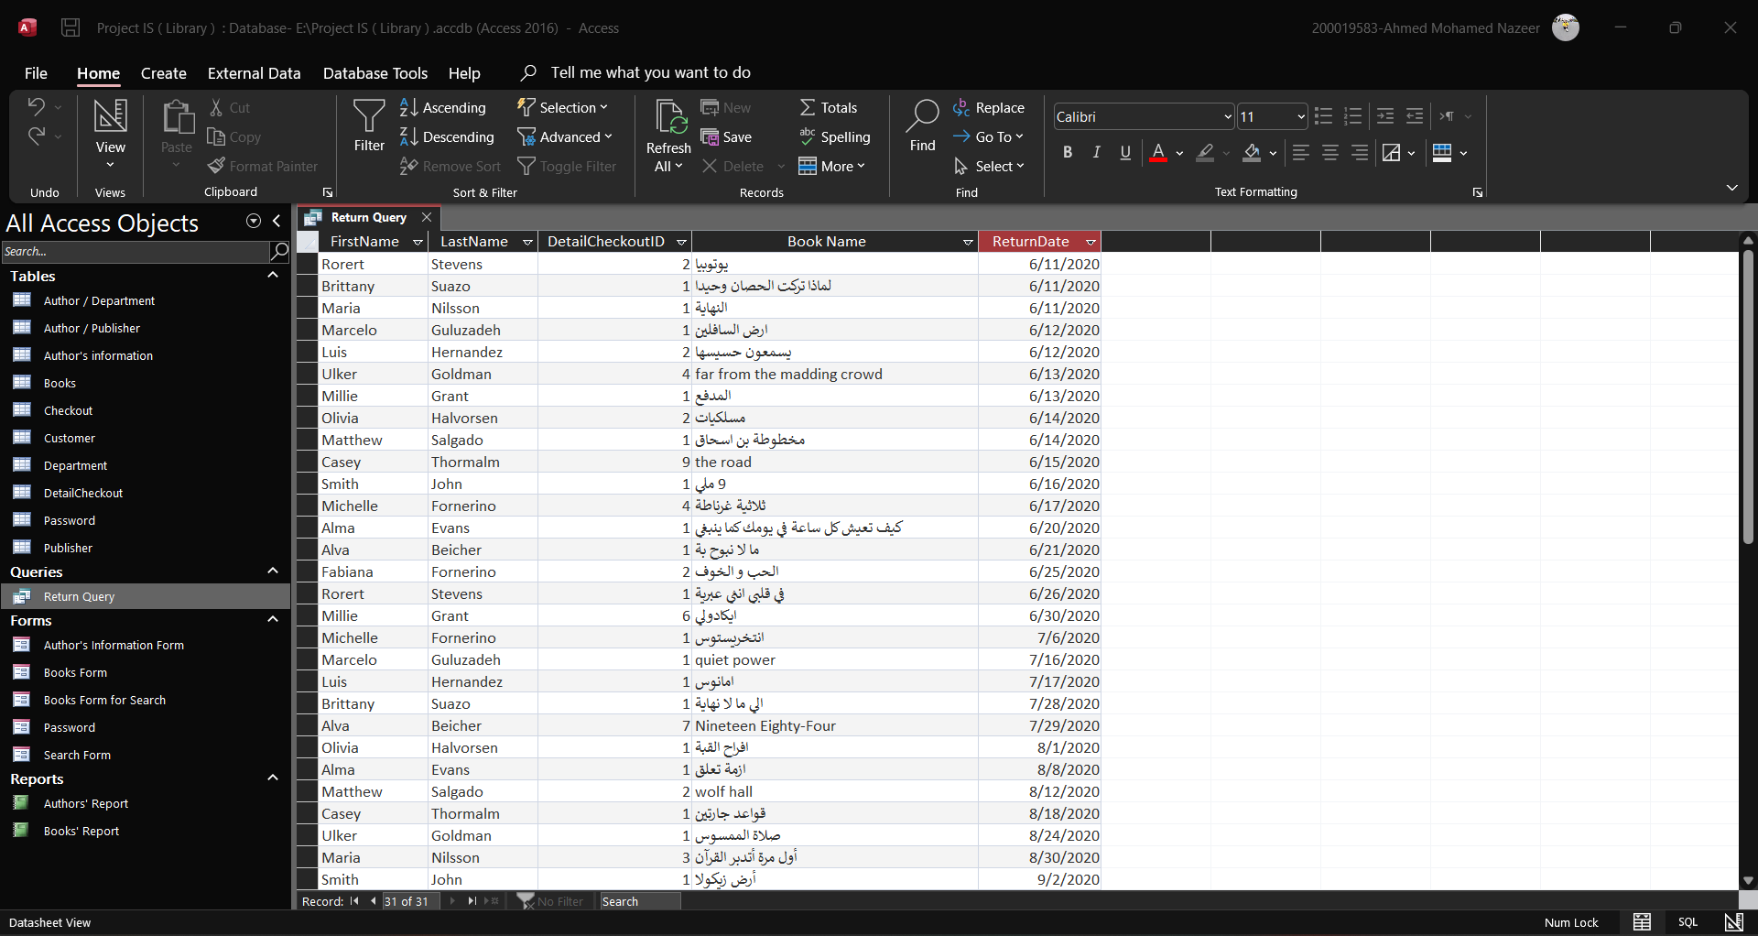
Return Query

Slide 18
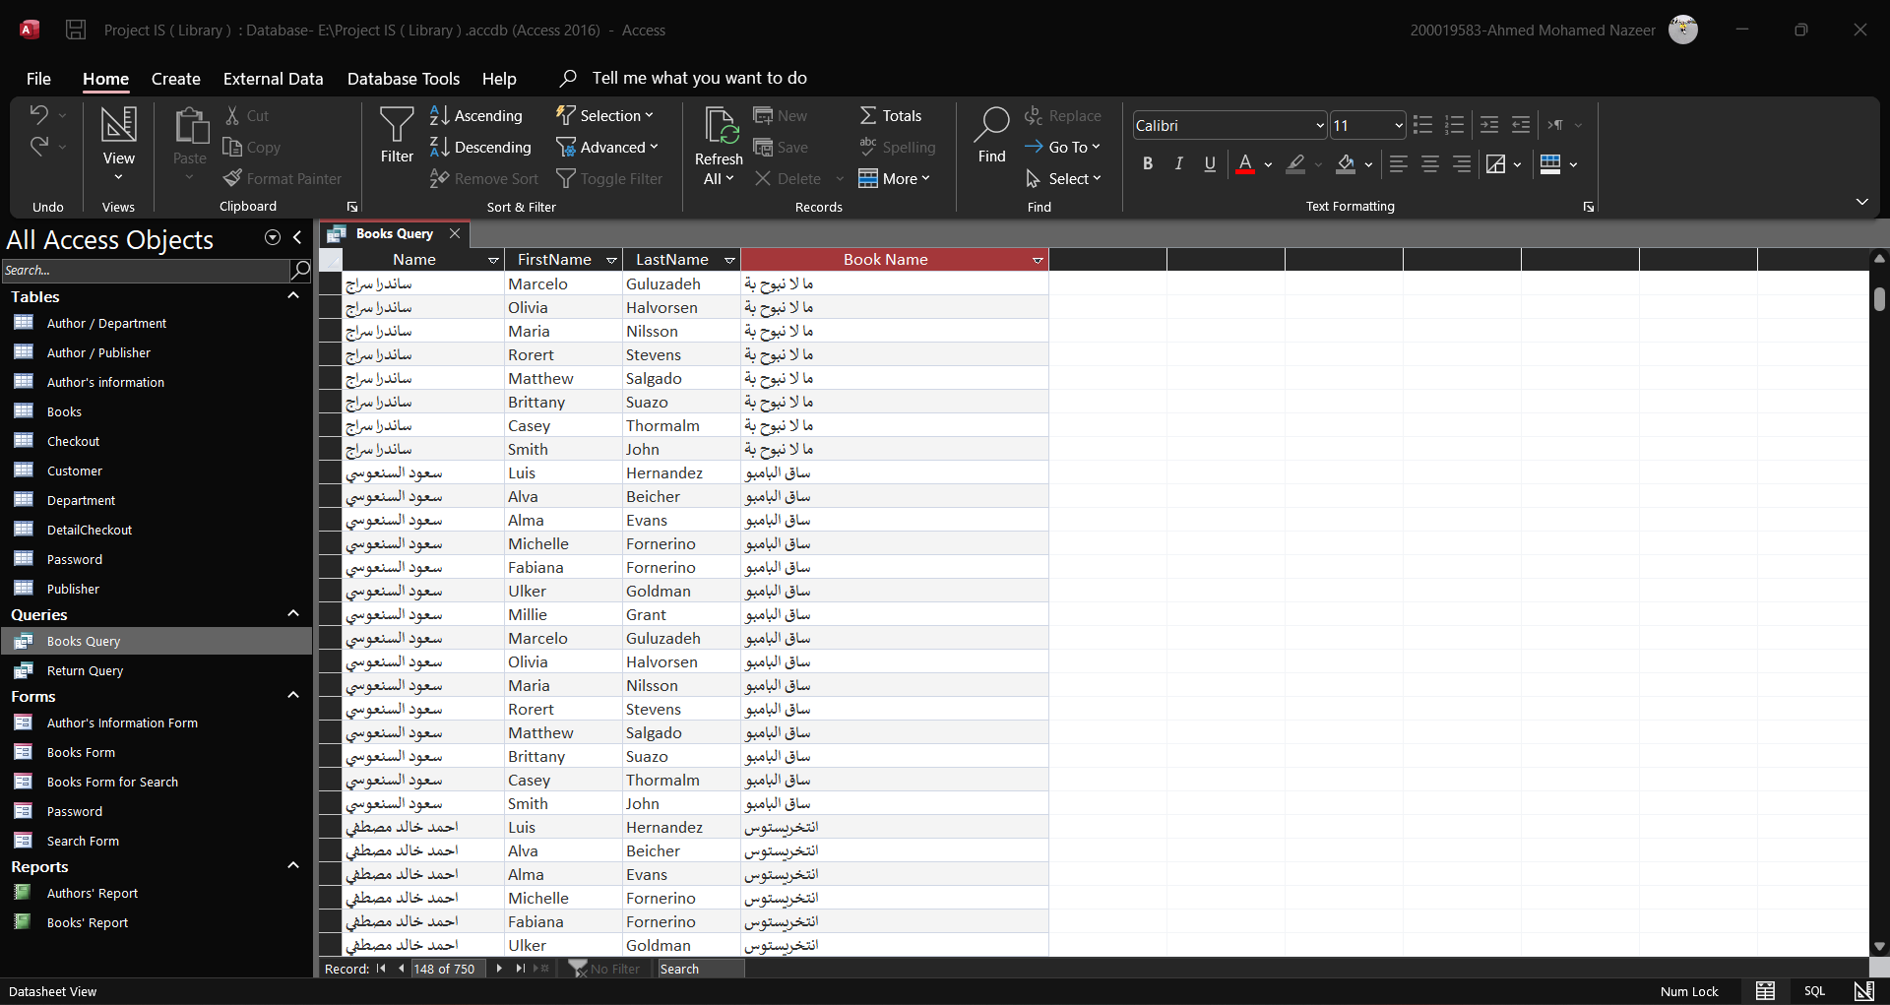
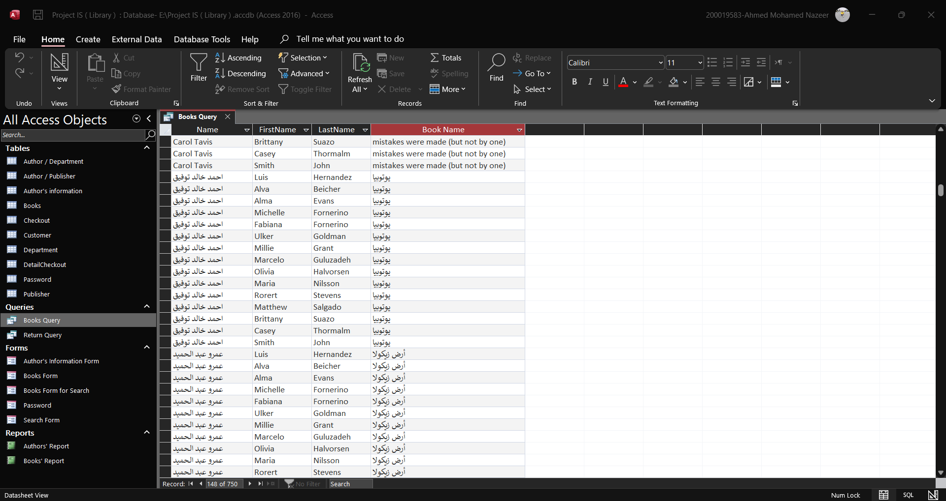
Books Query

Slide 19
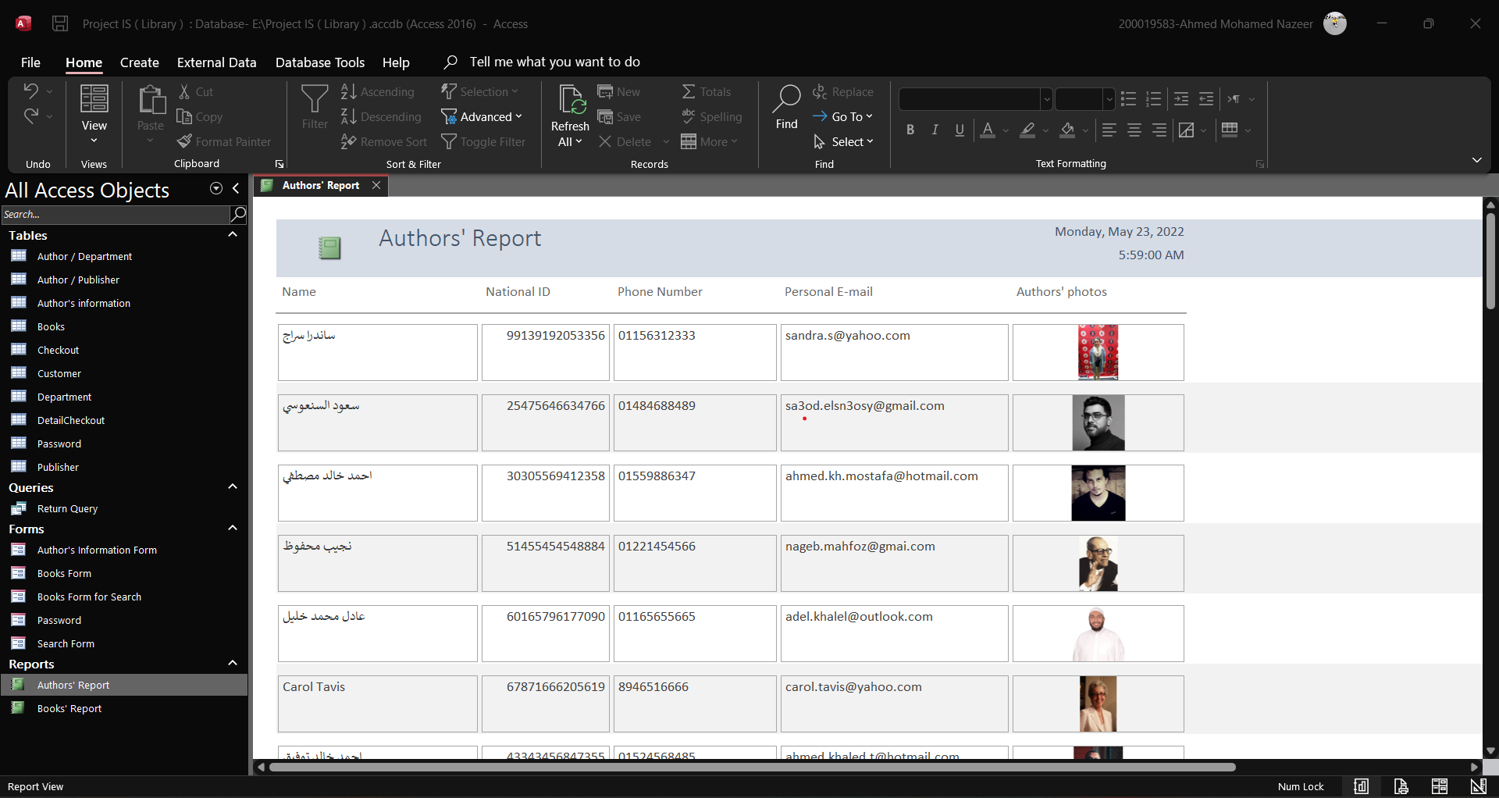
Authors’ Report

Slide 20
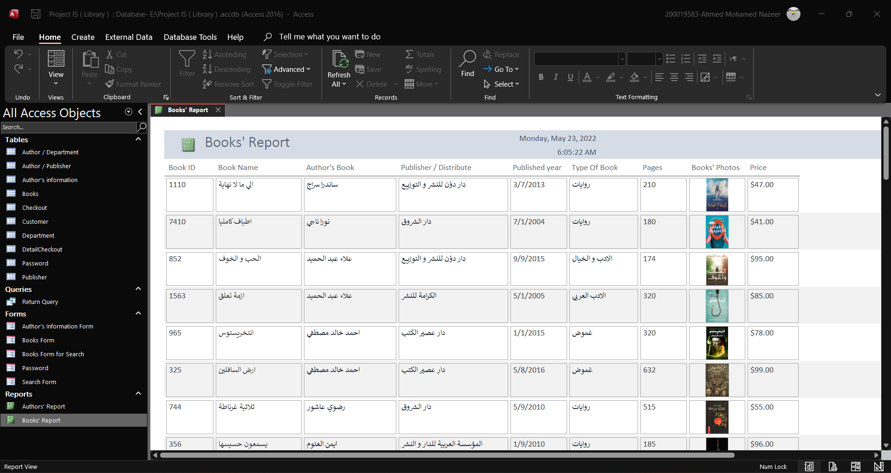
Books’ Report

Slide 21

Thank You

